Slide 1




Introduction to Drupal
Use Drupal as CMS/CMF

Slide 2



Lectors
Vasil Boychev
Drupalist since 2010
Certified Drupal Developer
Team Lead & Project Manager at FFW
Board Member at Drupal Bulgaria

Slide 3

Lectors
Petyo Stoyanov
Drupalist since 2010
FE Trainer since 2012
Web Developer at WebHills

Slide 4
Agenda
What is Drupal?
Where does it come from?
What can we do with it?
Who’s using it?
Installation of Drupal 7
Notes:
Drupal 7 introduced the concept of entities to the open source platform. Entities are field-able objects that serve specific purposes but share common base level functionality. We have already mentioned some existing entities: nodes, users, taxonomy terms & comments.

Slide 5
What is Drupal
Completely free, open source CMS
Can be used for wide variety of web solutions
Strong community of users and developers
Incredibly flexible content management framework

Slide 6
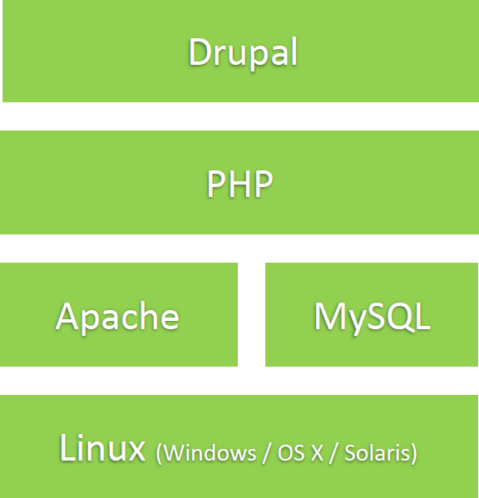
Built on LAMP/MAMP/WAMP

Slide 7
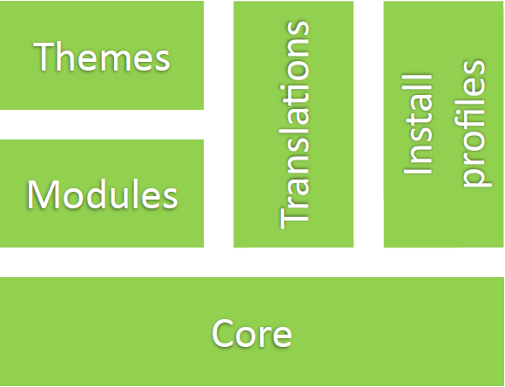
Architecture

Slide 8
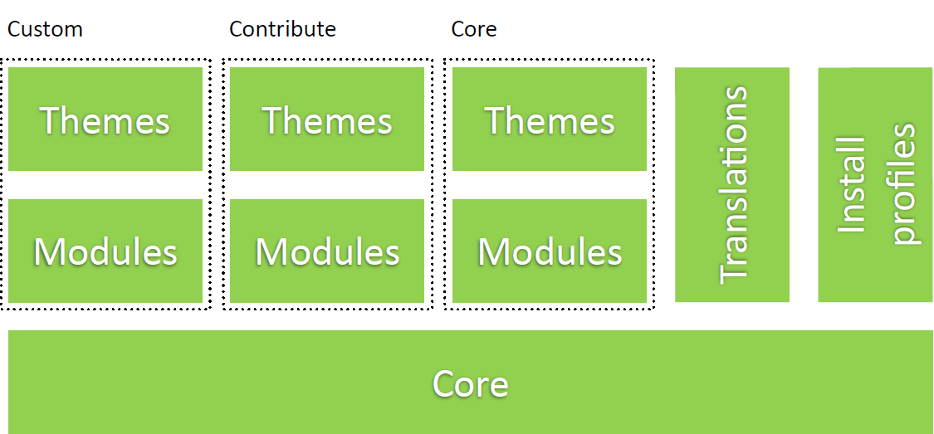
Pluggable

Slide 9

Where does it come from?
Dries Buytaert
Founder and Project Lead of Drupal
Co-founder and President of the Drupal Association
Co-founder and CTO of Acquia
Notes:
Drupal Commerce introduces several new entities to your site: Products, Orders, Line Items, Payment Transactions & Customer Profiles. Products
Products represent something you’re trying to sell, physical or not. It has a title and a price associated with it. To give an end user the ability to place an instance of a product in their cart, you will need to make a product reference on a node page the end user sees.
Orders
Orders start out as carts. They are a container that holds all of the information given your current shopping experience. It contains line items, which are specific instances of products with options attached. It contains customer information after the order is successful. It also contains any successful and unsuccessful references to payment transactions.
Line Items
Line Items represent an instance of a product in your cart (or order) with options attached. For example, if a product is a T-Shirt with the ability to choose a color and a user places a T-Shirt in the cart with the red option chosen, a line item with that specific product reference and options is added to the cart.
Payment Transactions
Payment Transactions hold all of the detailed financial metadata for every attempt to checkout with line items in the cart. Payment transactions usually hold the amount paid, timestamps and some payload information from the payment gateway.

Slide 10
The name
dorp.org -> drop.org (small typo)
Drupal - English pronunciation of the Dutch word "druppel“, which means "drop"

Slide 11
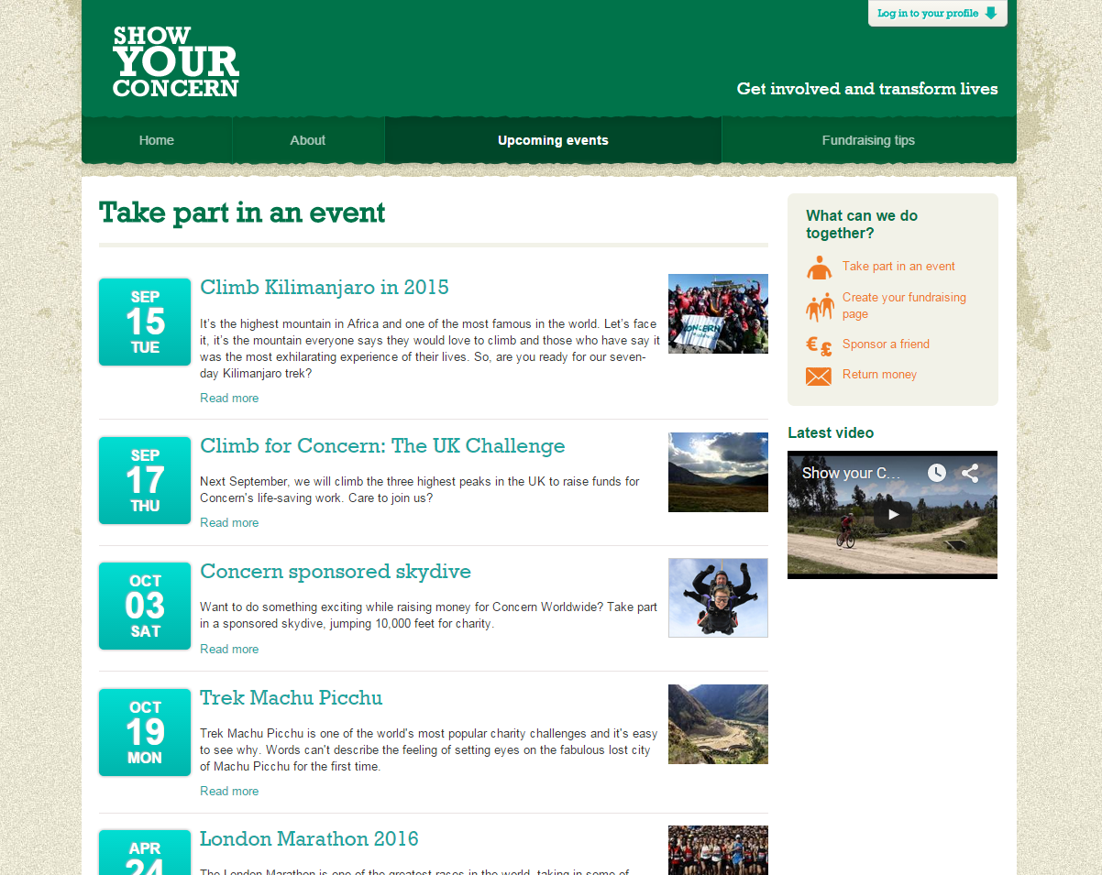
For what we can use Drupal?
Community Platform

Slide 12
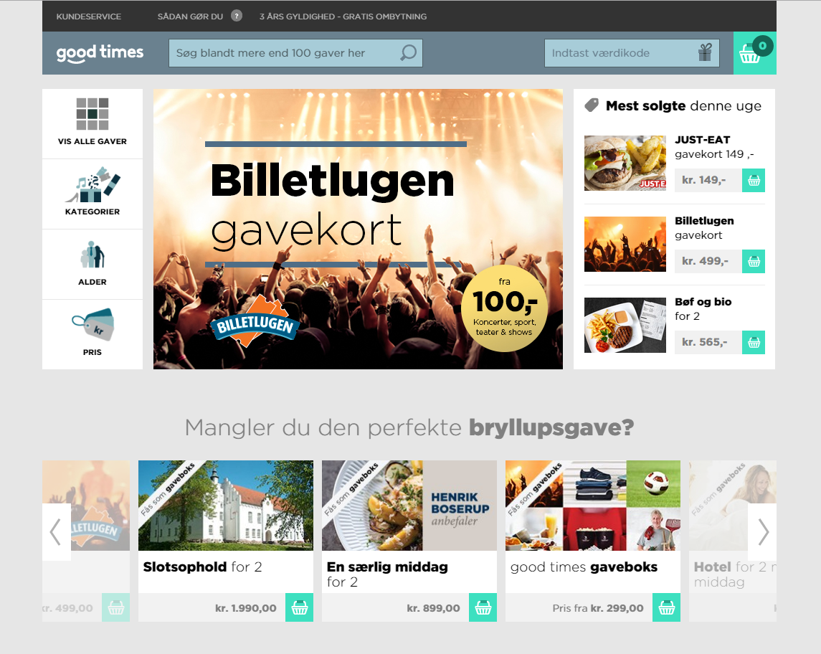
For what we can use Drupal?
E-commerce

Slide 13
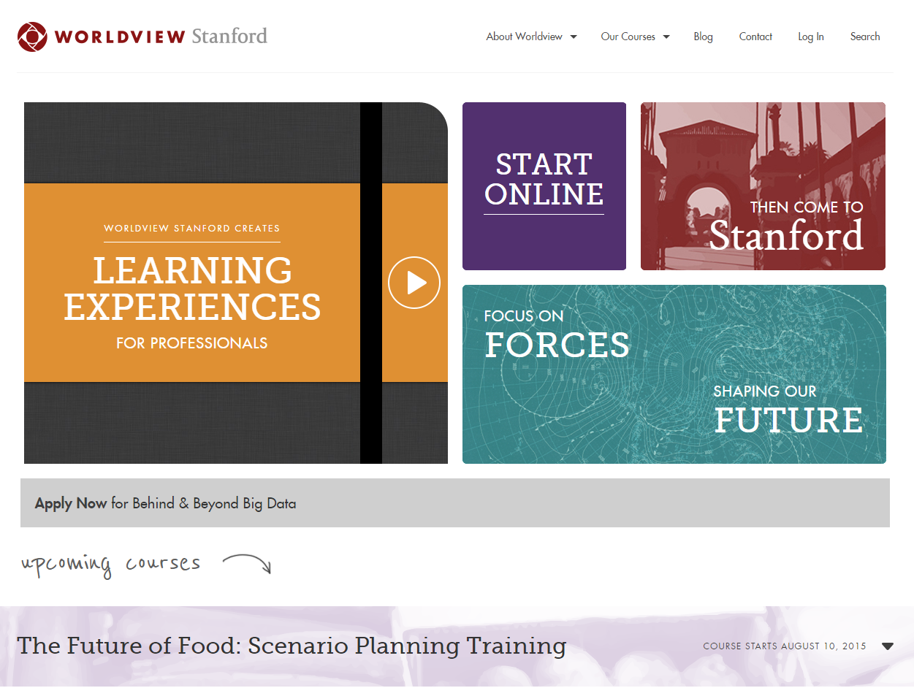
For what we can use Drupal?
Education

Slide 14
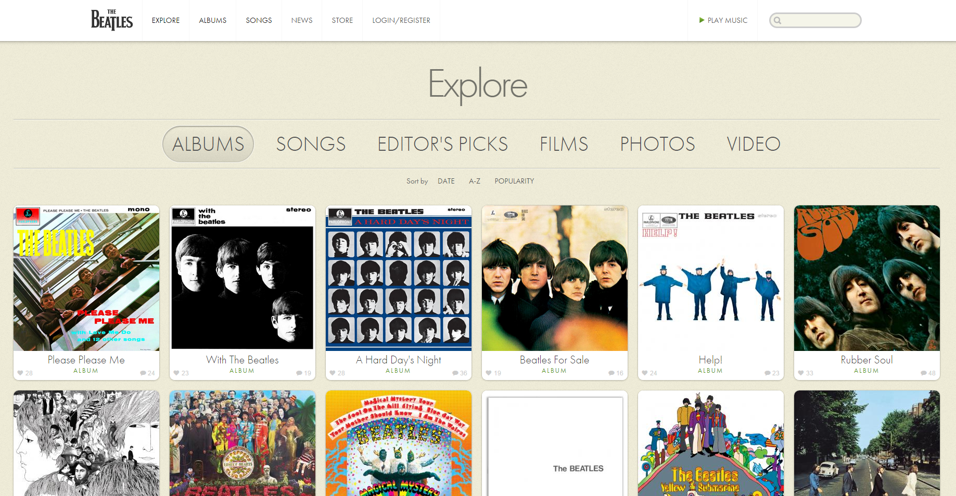
For what we can use Drupal?
Entertainment

Slide 15
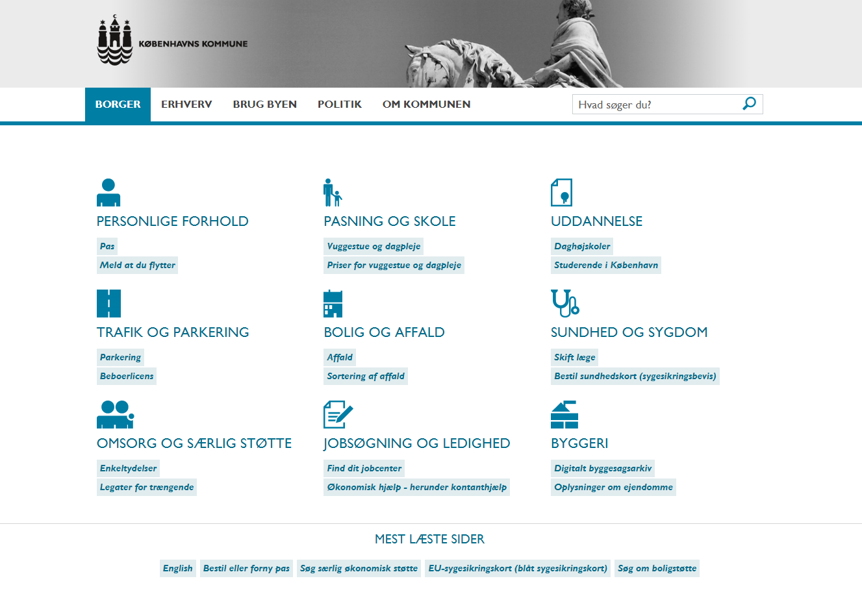
For what we can use Drupal?
Governent

Slide 16
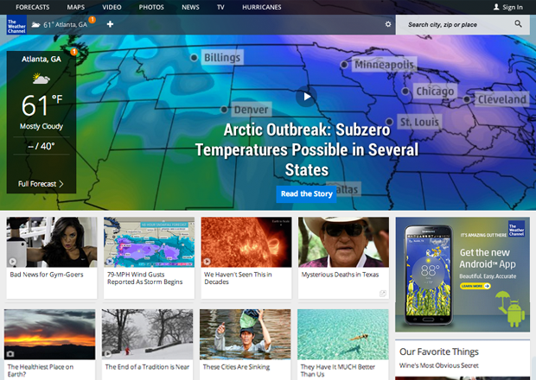
For what we can use Drupal?
Media

Slide 17
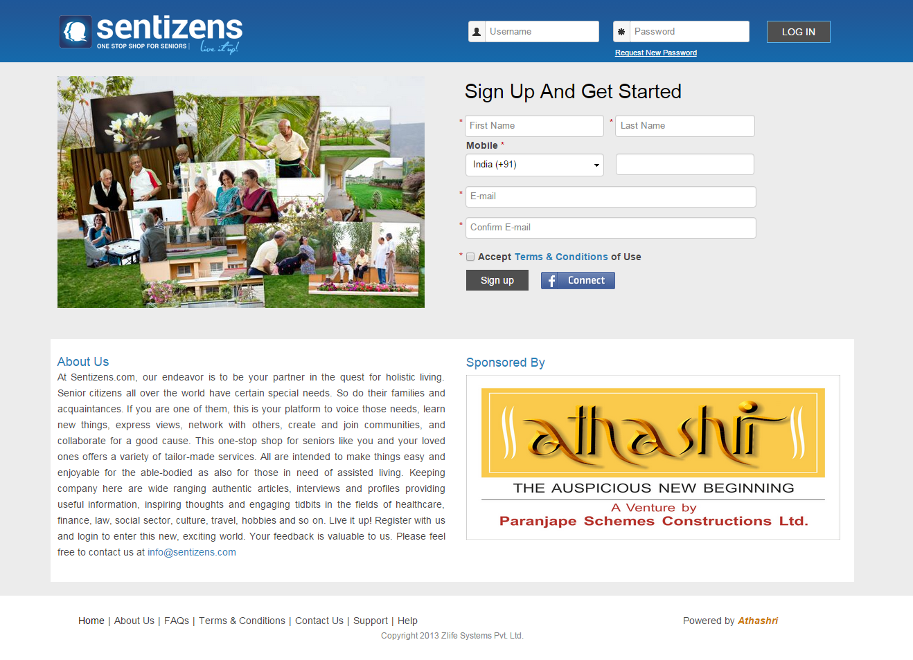
For what we can use Drupal?
Social Networking

Slide 18
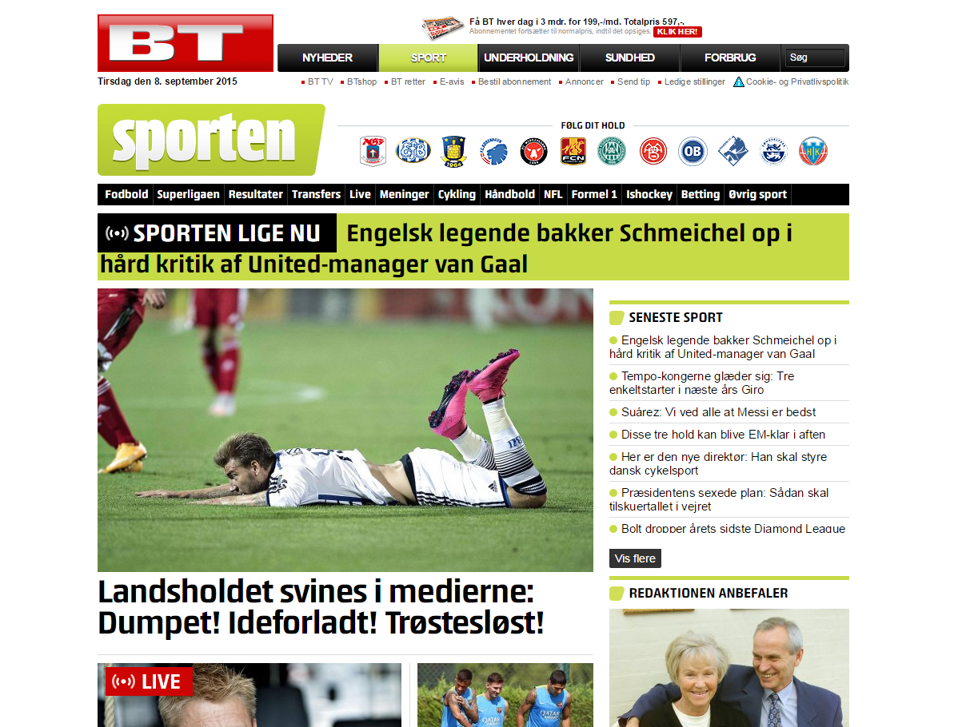
For what we can use Drupal?
Sport

Slide 19
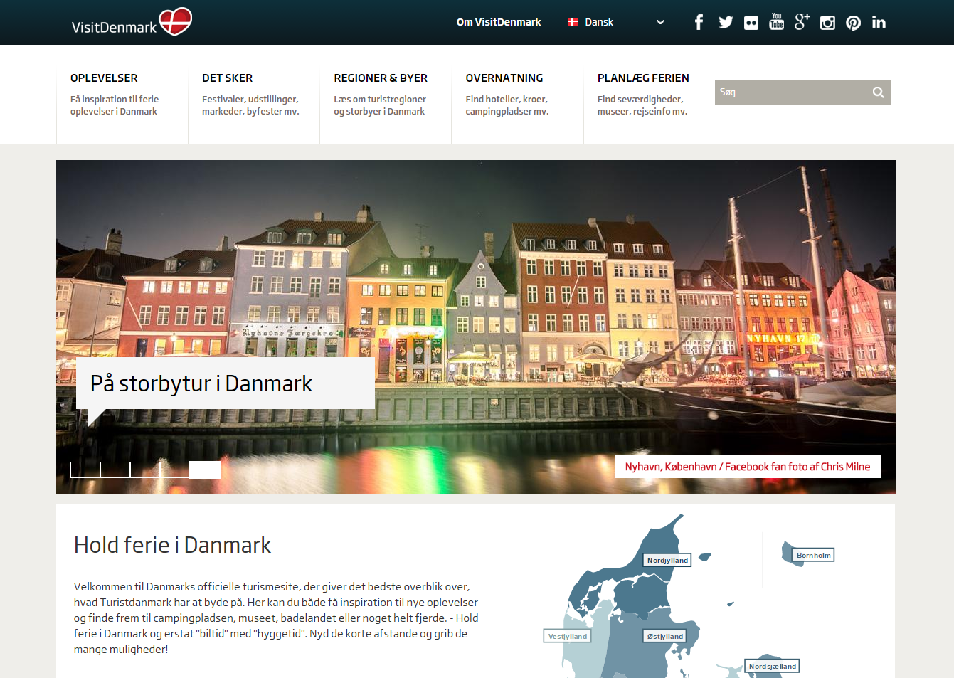
For what we can use Drupal?
Travel and Hospitality

Slide 20
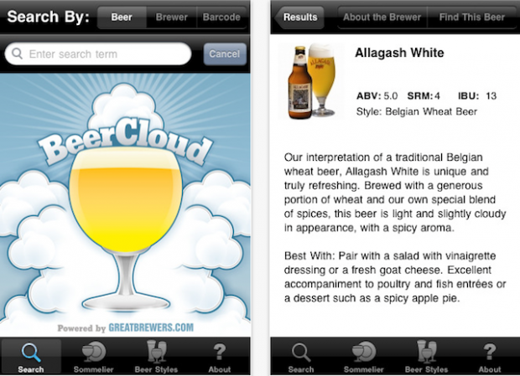
For what we can use Drupal?
Web Services + Beer = BeerCloud on Mobile

Slide 21

Who uses Drupal?

Slide 22
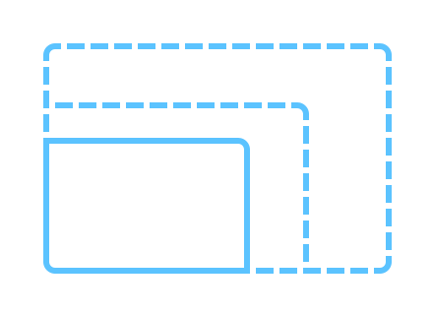
Why we use Drupal?
Scalability Matters
Notes:
Drupal commerce supports two types of tax out of the box. Sales tax, which is used mostly in the US, and VAT which is more commonly used. With VAT the total is shown to the customer with the tax already included in the price and nothing is added to the subtotal section. Tax is implemented through Commerce Rules.

Slide 23

Why we use Drupal?
Responsive Everywhere
Notes:
Drupal commerce supports two types of tax out of the box. Sales tax, which is used mostly in the US, and VAT which is more commonly used. With VAT the total is shown to the customer with the tax already included in the price and nothing is added to the subtotal section. Tax is implemented through Commerce Rules.

Slide 24
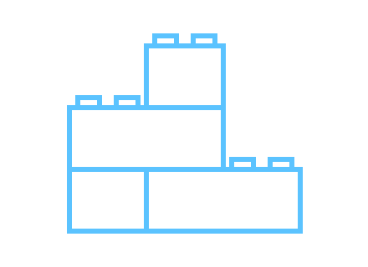
Why we use Drupal?
Connected
Notes:
Drupal commerce supports two types of tax out of the box. Sales tax, which is used mostly in the US, and VAT which is more commonly used. With VAT the total is shown to the customer with the tax already included in the price and nothing is added to the subtotal section. Tax is implemented through Commerce Rules.

Slide 25
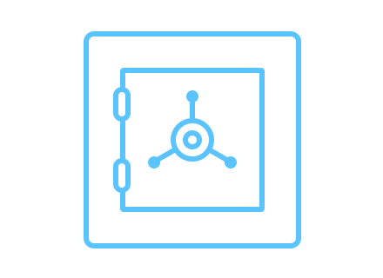
Why we use Drupal?
Security
Notes:
Drupal commerce supports two types of tax out of the box. Sales tax, which is used mostly in the US, and VAT which is more commonly used. With VAT the total is shown to the customer with the tax already included in the price and nothing is added to the subtotal section. Tax is implemented through Commerce Rules.

Slide 26

Why we use Drupal?
Content editing
Notes:
Drupal commerce supports two types of tax out of the box. Sales tax, which is used mostly in the US, and VAT which is more commonly used. With VAT the total is shown to the customer with the tax already included in the price and nothing is added to the subtotal section. Tax is implemented through Commerce Rules.

Slide 27
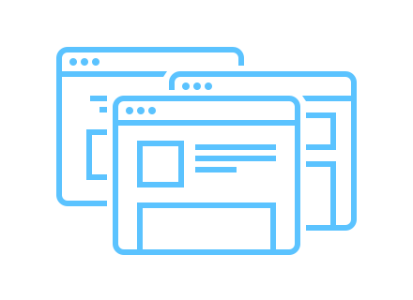
Why we use Drupal?
Multisite
Notes:
Drupal commerce supports two types of tax out of the box. Sales tax, which is used mostly in the US, and VAT which is more commonly used. With VAT the total is shown to the customer with the tax already included in the price and nothing is added to the subtotal section. Tax is implemented through Commerce Rules.

Slide 28
Why we use Drupal?
Multisite
Notes:
Drupal commerce supports two types of tax out of the box. Sales tax, which is used mostly in the US, and VAT which is more commonly used. With VAT the total is shown to the customer with the tax already included in the price and nothing is added to the subtotal section. Tax is implemented through Commerce Rules.

Slide 29

Why we use Drupal?
Multilingual
Notes:
Drupal commerce supports two types of tax out of the box. Sales tax, which is used mostly in the US, and VAT which is more commonly used. With VAT the total is shown to the customer with the tax already included in the price and nothing is added to the subtotal section. Tax is implemented through Commerce Rules.

Slide 30
Why we use Drupal?
Multilingual
Notes:
Drupal commerce supports two types of tax out of the box. Sales tax, which is used mostly in the US, and VAT which is more commonly used. With VAT the total is shown to the customer with the tax already included in the price and nothing is added to the subtotal section. Tax is implemented through Commerce Rules.

Slide 31

Why we use Drupal?
Community
Notes:
Drupal commerce supports two types of tax out of the box. Sales tax, which is used mostly in the US, and VAT which is more commonly used. With VAT the total is shown to the customer with the tax already included in the price and nothing is added to the subtotal section. Tax is implemented through Commerce Rules.

Slide 32
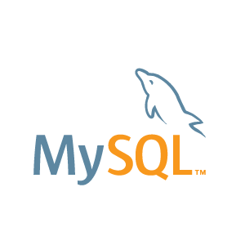


What do I need to know?
Some programming
Notes:
Drupal commerce supports two types of tax out of the box. Sales tax, which is used mostly in the US, and VAT which is more commonly used. With VAT the total is shown to the customer with the tax already included in the price and nothing is added to the subtotal section. Tax is implemented through Commerce Rules.

Slide 33
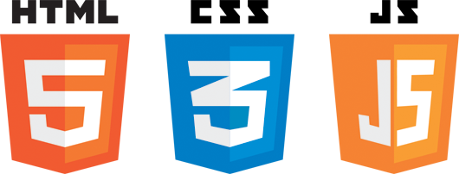
What do I need to know?
Some client-side stuff
Notes:
Drupal commerce supports two types of tax out of the box. Sales tax, which is used mostly in the US, and VAT which is more commonly used. With VAT the total is shown to the customer with the tax already included in the price and nothing is added to the subtotal section. Tax is implemented through Commerce Rules.

Slide 34


What do I need to know?
Some design
Notes:
Drupal commerce supports two types of tax out of the box. Sales tax, which is used mostly in the US, and VAT which is more commonly used. With VAT the total is shown to the customer with the tax already included in the price and nothing is added to the subtotal section. Tax is implemented through Commerce Rules.

Slide 35

Thank You!
Notes:
Robin Hood is a non-profit poverty fighting organization in NYC, one of the most effective. They have integrated donation solution on Drupal Commerce.
Listen what they say about Drupal Commerce:
“In March, Robin Hood started accepting donations utilizing Drupal Commerce. We used the concept of products to create a customized product type called “donation product.” The donation product displays are referred to by nodes called campaigns. A site administrator can set up a campaign and associate one or many different types of donation products, representing different amounts or the desire to have a recurring donation given a certain frequency of time.
After adding a donation product to their cart, a user is taken to the checkout process where some extra meta-information can be added to your donation, such as being anonymous or making the donation in honor of someone. All of these extra options are stored in fields kept in custom line items called “donation line items.”
The donor inputs payment information and upon success is taken to a confirmation page and emailed a receipt for tax purposes.
All of this was made possible by the flexibility of entities and the vast amount of hooks we were able to implement to customize the checkout process.”

